Slide 1



Project: HR Analytics
Presented by Project-P117 Team 5
Team members: KIRAN JADHAV
NEHA SINGH
SHUBHAM KAND
ASHWINI P
RAHIUL YADAV
SANDEEP PULI
Mentors:
NEHA MAM

Slide 2
DATA SETS
ITS WAS THE 2 EXCEL FILES WHICH ONE WAS HR1 AND HR 2 WE MERGE THE DATA BY SAME COLUMN IN BOTH DATA SETS .
THERE IS 5001 ROWS AND 36 COLUMN IN DATA SET
Objective:
• The main purpose here is to determine those aspects of HR management that must be prioritized and improved to allow the HR to perform better.
• HR analytics is concerned with many areas of the organization at large. This could include day-to-day HR operations, procedure efficiencies, or strategic organizational issues in other areas.

Slide 3
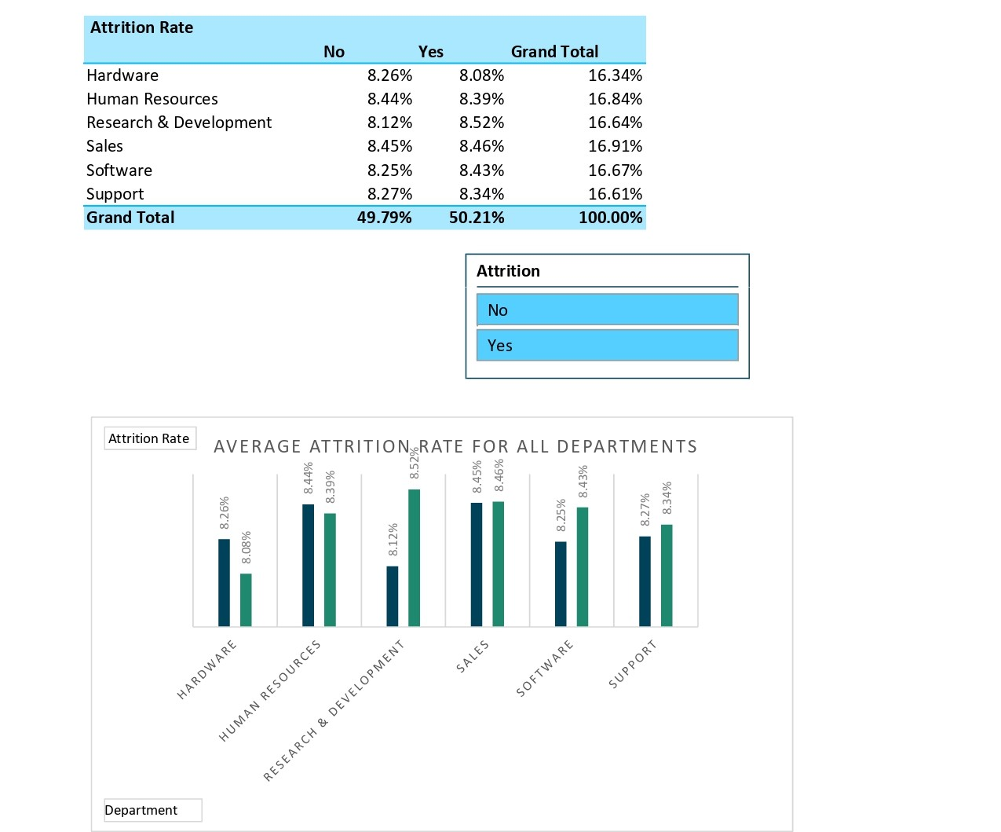
KPI – I
d
1.Average Attrition rate for all Departments
The average attrition ratio across all five departments falls within the range of 49% to 50%. The Research department exhibits the highest attrition rate, while the Hardware department shows the lowest. This data can provide insights into employee retention and inform future workforce planning strategies.
• Range: 49% to 50%
• Highest: Research Department
• Lowest : Hardware Department

Slide 4
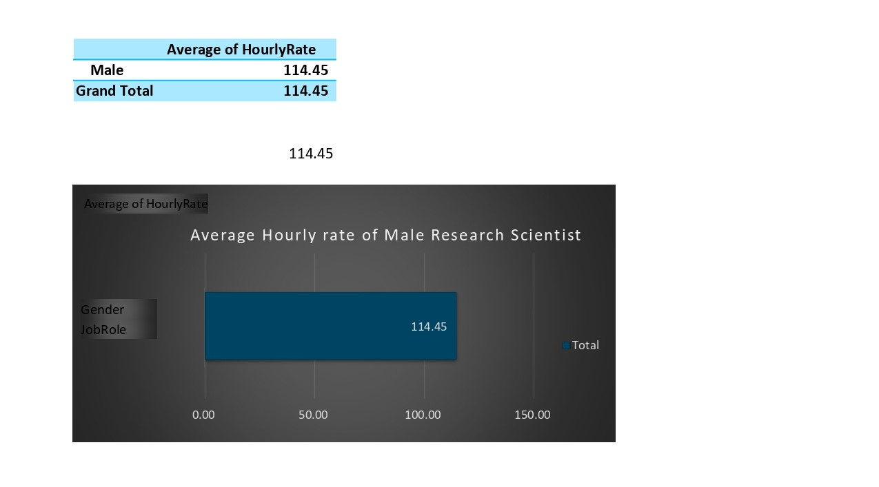
KPI – II
2.Average Hourly rate of Male Research Scientist
• The average hourly rate for male employees in the job role of Research Scientist is $115.
This information can be useful for analyzing pay equity and ensuring that male and female employees in similar roles are compensated fairly. It can also inform recruitment efforts and salary negotiations for future employees in this job role.

Slide 5
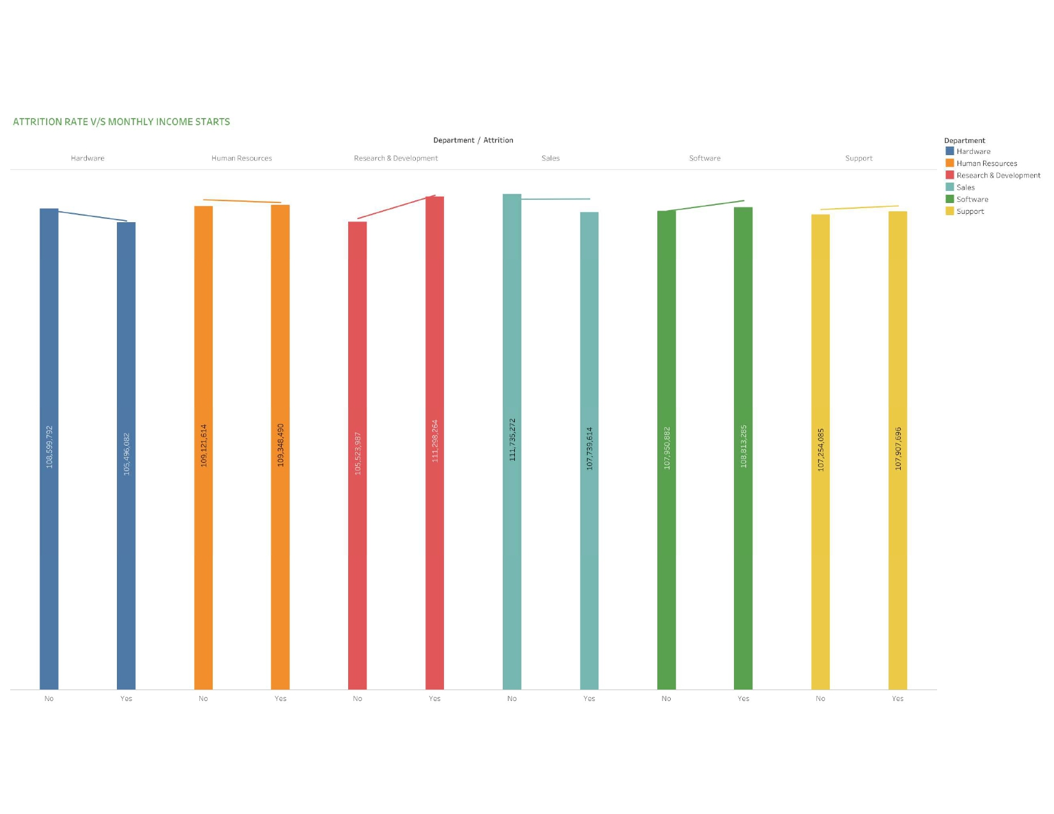
KPI – III
3.Attrition rate Vs Monthly income stats.
The data reveals that the highest attrition rate is observed in the income range of $48,000 to $52,000, while lowest Atrision rate is observed in the range of $36,000 to $40,000. These insights can be valuable for understanding the Refationship between Income and employee retention and inform compensation and benefits strategies to improve employee retention in the higherincomo bracket .

Slide 6
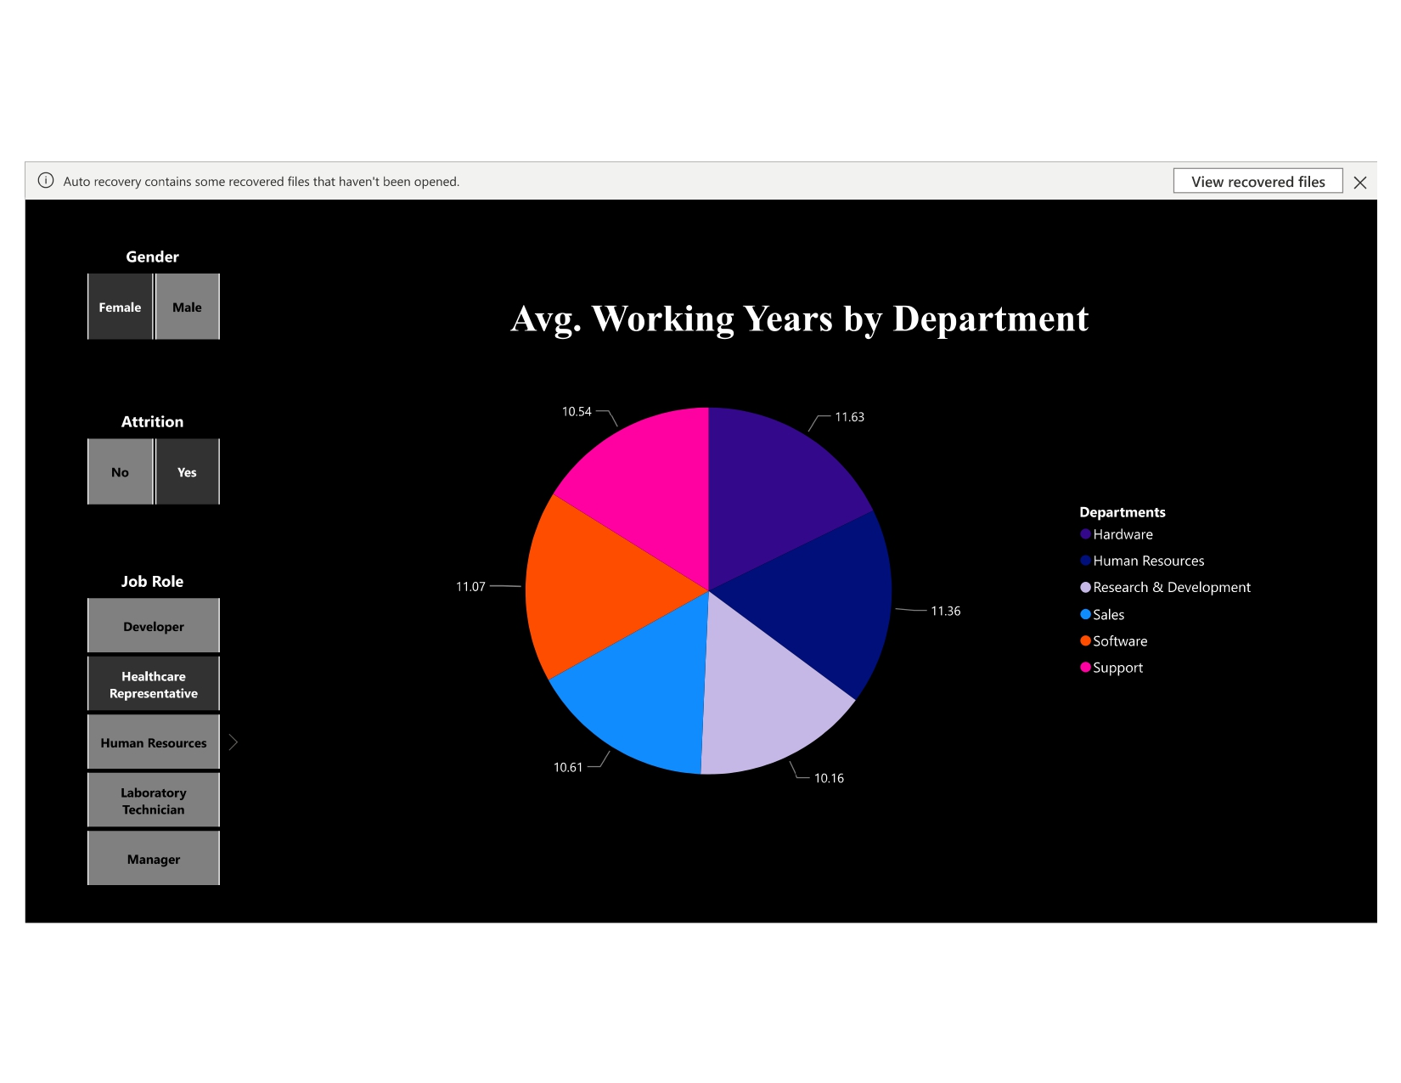
KPI – IV
4.Average working years for each Department
The average working years of employees in each department have been analysed and visualized using a donut chart. The overall average working years for all departments is 20.50. The Human Resources department has the highest average working years, while the Sales department has the lowest. These findings can provide insights into employee retention and inform strategies to retain emplayees for longer durations. It can also inform succession planning efforts and guide decision-making regarding promotions andcareer growth opportunities for employees in ditterent departments.

Slide 7
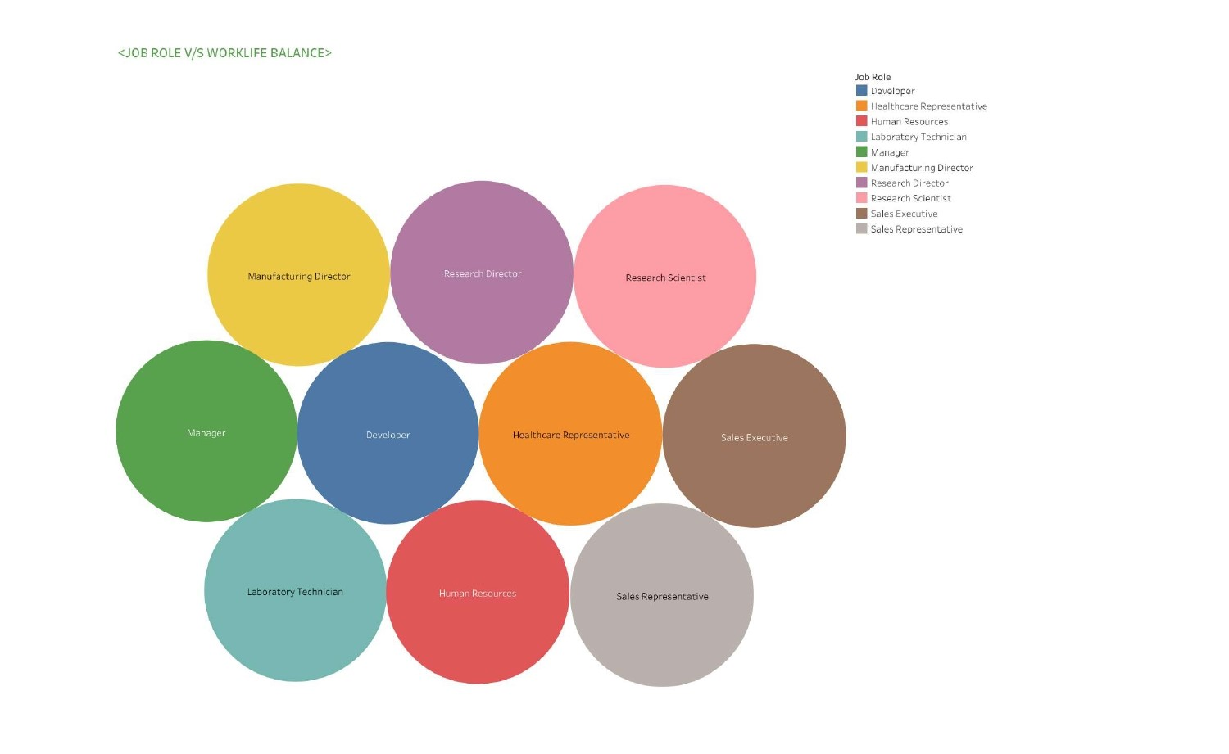
KPI – V
5.Job Role Vs Work life balance
Our analysis indicates that the work-life balance varies across different job roles and is assessed across four dimensions. The human resources job role scores a high work-life balance of 25.2%, while the research director job role scores a low work-life balance of 25.6%. These findings can assist organizations and individuals in making informed decisions regarding job roles and work-life balance.
•

Slide 8
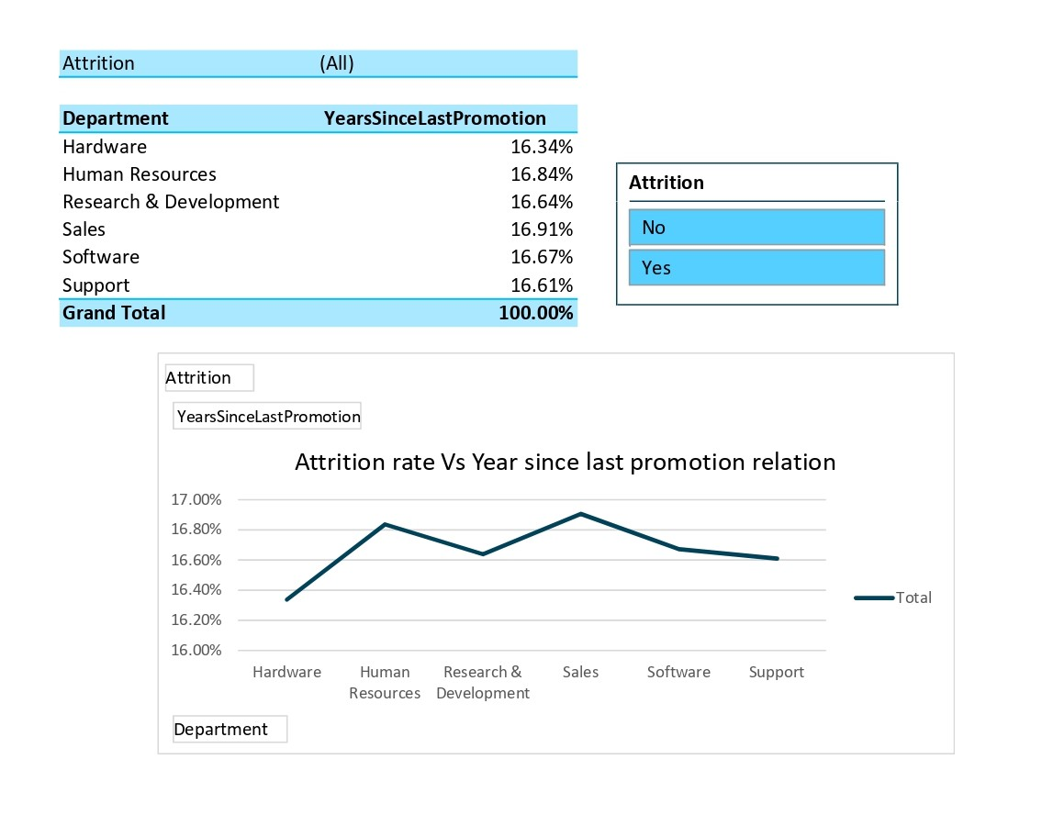
KPI – VI
6.Attrition rate Vs Year since last promotion relation
The data reveals that the highest Attrition rate of 60% is observed in the 36-40 years since last promotion bin, while the lowest attrition rate of 49.66% is observed in the 11-15 years since last promotion bin. These findings can be valuable for understanding the impact of promotion opportunities on employee retention and inform strategles to retain employees for longer durations. It can also guide decision-making regarding promotion timelines and opportunities for employees in different stages of their careers.
•

Slide 9
CONCLUSION
🠶 The date set had a lot of duplicate values which was a challenge whether to remove it or not.

Slide 10


